Slide 1
14ᵗʰ / 38
WINTER DATA ANALYSIS CHALLENGE 2026
Is Australia
Doing Well?
One country, three verdicts — a stress-tested well-being audit, 2010–2025.
TEAM O for 4
Atharva Aher (SID 55088718) · Mokshithh Kethari (SID 550809791)
Notes:
Is Australia doing well? The tempting answer is to build one number and rank it. We did — and then spent the whole project trying to break it.

Slide 2
THE QUESTION
The tempting answer is one number.
14th
But a single number is the least honest way to answer a vague question.
So we refined it: is that rank robust to how we measure, to which dimensions we count, and to which way the country is moving?
of 38 OECD countries
on a composite well-being score
Notes:
On the OECD's well-being data, Australia comes fourteenth of thirty-eight. But a single number is the least honest way to answer a vague question — so we refined it, and spent the rest of the project trying to break our own verdict.

Slide 3
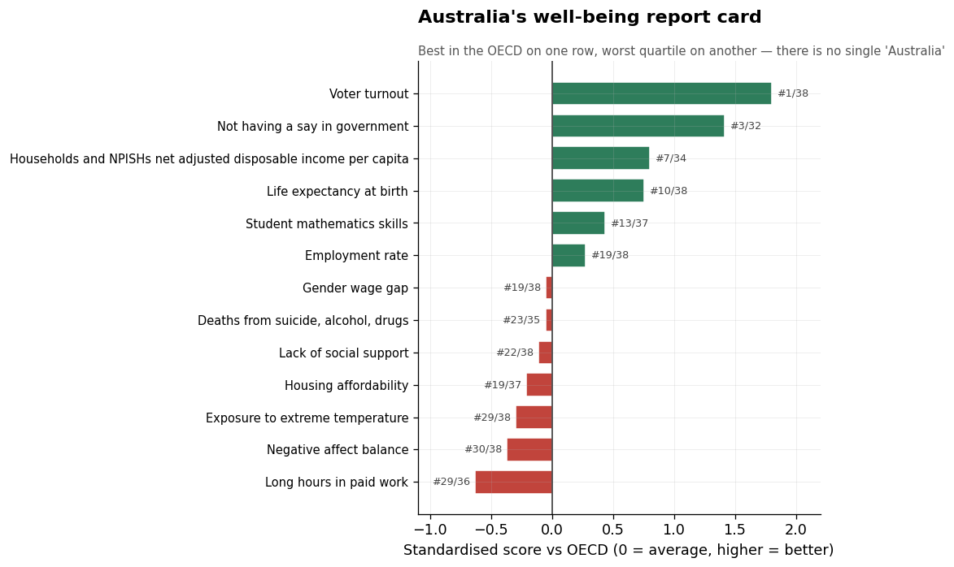
FINDING 1
Australia is not one thing
✓
Best in the OECD
voter turnout · income · life expectancy
✗
Worst quartile
long hours · negative emotions · heat exposure
Averaging these into one score doesn't summarise Australia — it erases it.
Notes:
Standardised against the OECD, Australia is best in the club on voter turnout, top-ten on income and life expectancy — and at the same time bottom-quartile on long hours, negative emotions and heat. Averaging those doesn't summarise Australia. It erases it.

Slide 4
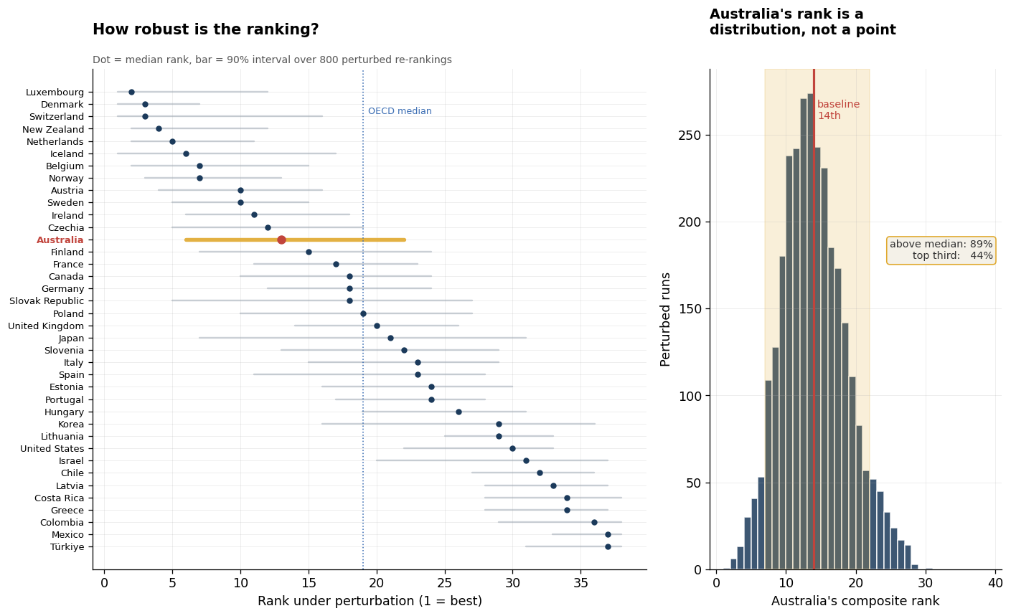
FINDING 2
Only “above average” is robust
89%
of perturbed worlds keep Australia above the OECD median
44%
reach the top third — “best” is a recipe choice
−8
places if we drop compulsory voting alone
Notes:
Is even the fourteenth real? A three-thousand-run Monte-Carlo — noise plus indicator resampling — keeps Australia above the OECD median in eighty-nine percent of worlds, but in the top third only forty-four. Above average is a finding; among the best is a recipe choice. The biggest lever: compulsory voting.

Slide 5
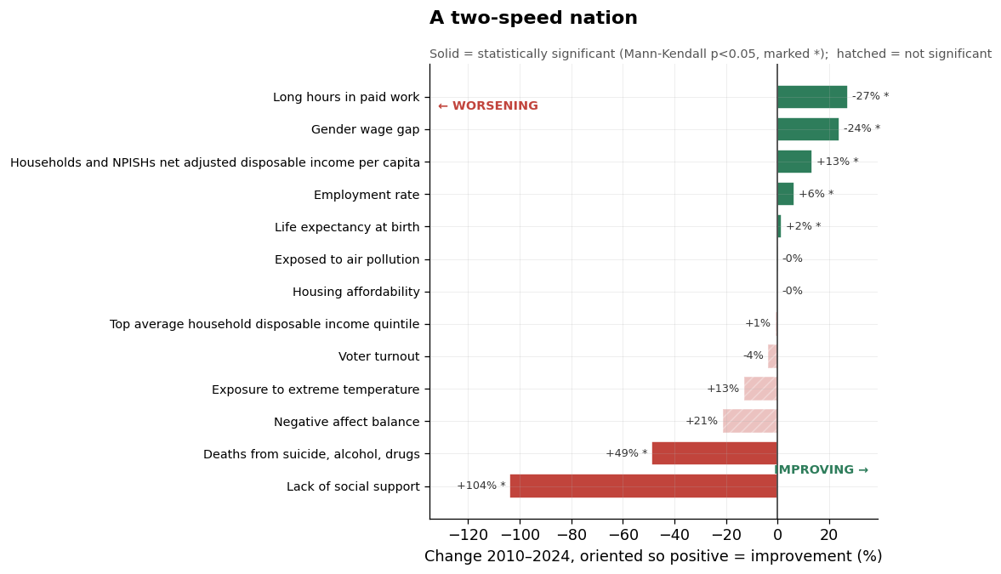
FINDING 3
A two-speed nation
✓
Significantly improving
income · employment · life expectancy · falling work hours & wage gap
✗
Significantly worsening
social support · deaths from suicide, alcohol & drugs
Richer and fairer at work — lonelier and more self-destructive.
Notes:
A rank is a snapshot; direction matters more. Tested with Mann-Kendall and Theil–Sen, built from scratch, the country splits cleanly and the split is real. Improving: income, jobs, life expectancy, even falling work hours. Worsening: social support, and deaths of despair. Richer at work, lonelier at heart.

Slide 6
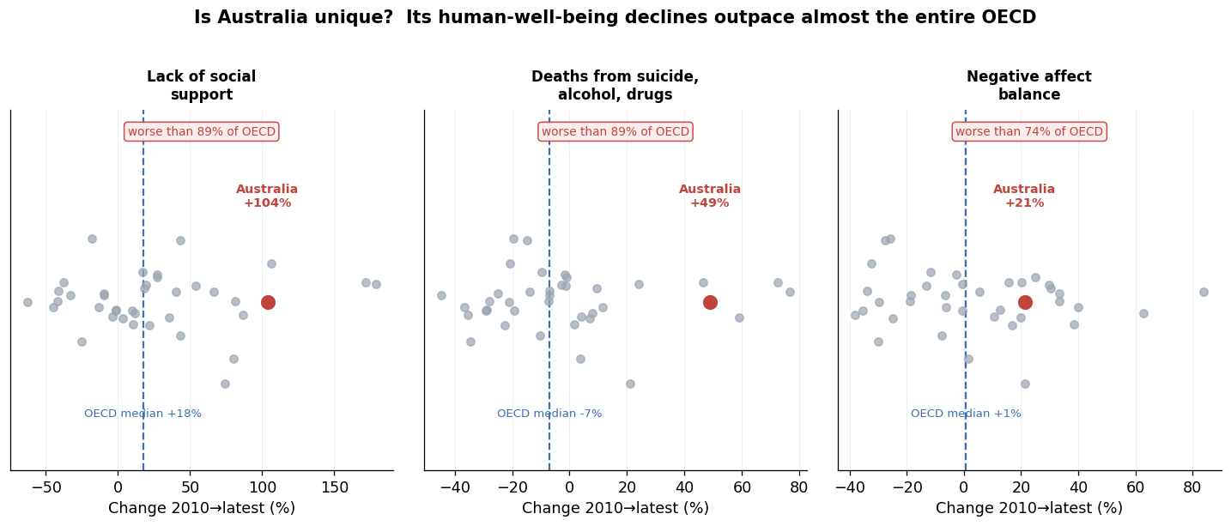
FINDING 4
Leading the decline, not sharing it
Maybe every rich country is getting lonelier? Against the whole OECD, the rebuttal fails.
Notes:
The obvious rebuttal: maybe everyone's getting lonelier. It fails. Australia's rise in loneliness and in deaths of despair each outpaced roughly eighty-nine percent of the OECD — and on deaths of despair, the OECD median actually fell. On its weakest dimensions, Australia moves against the pack.

Slide 7
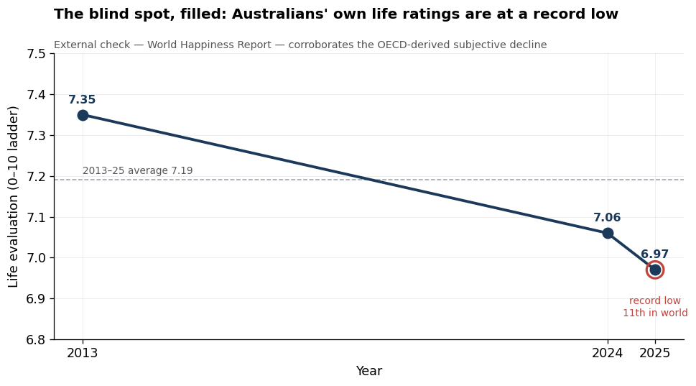
FINDING 5
The blind spot, filled
Life-satisfaction data goes dark after 2020 — exactly where the trouble is.
So we filled that one gap with an external source.
6.97 record low, 11ᵗʰ in the world
Notes:
Our data has a hole — the most damning one. Life satisfaction goes dark after 2020, exactly where we found trouble. We filled it with the World Happiness Report: Australians' own life ratings have slid to a record-low six-point-nine-seven, eleventh in the world. A different survey, the same verdict.

Slide 8
THE VERDICT
Above average — and quietly sliding
on the things hardest to count.
✓
The 20ᵗʰ-century ledger
✗
The 21ˢᵗ-century ledger
Income · jobs · longevity — a durable, still-improving success.
Connection · distress · happiness — going backwards, faster than the OECD.
Australia's own “Measuring What Matters” framework (Treasury, 2023) was built on exactly this premise: GDP alone is not enough.
Notes:
So — is Australia doing well? Above average, and quietly sliding on the things hardest to count. In 2023 the Treasury launched Australia's first national well-being framework on exactly this premise. The data don't just answer the question — they say where to point: not the income line, which is fine. At connection, and distress.

